Slide 1

Switching response modalities in picture naming
Aikaterini Tsaroucha
Supervisors: Svetlana Pinet, Clara Martin
05.06.2023

Slide 2

SECTION 1: Background & Motivation
1

Slide 3



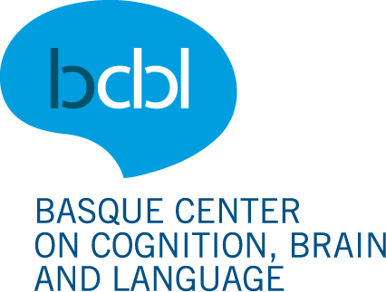


Background
Influence of phonology in L1 written (handwriting) production & of orthography in L1 oral (speaking) production.
Notes:
Interplay between written and oral output/response modalities.

Slide 4
Background
Does phonology constrain selection of orthographic representations in written picture naming? (Bonin et al., 2001)
Manipulated sound-spelling inconsistency (cygne – signe) and position of inconsistency.
Word-initial inconsistency slowed RTs compared to matched consistent words
Phonology does constrain the activation of orthographic representations (sublexical route) and is co-activated during writing.
Notes:
Predicted that performance will drop for inconsistent stimuli.
This consistency effect suggests that orthographic encoding is indeed influenced by phonology.
Heterographic homophones

Slide 5
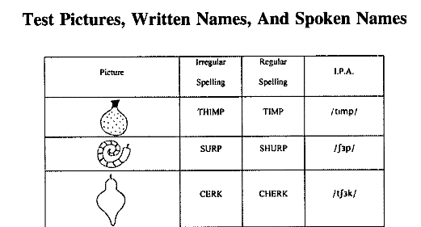
Background
Orthographic representations are activated during oral production (Rastle et al., 2011)
Novel word learning: novel pictures and novel spoken words
Manipulated spelling-sound consistency
Production: spelling regularity slowed RTs in picture naming
Emerged right after the new spellings were introduced on the 2nd day of training; persisted throughout the 3rd day of training.
Orthography is involved in tasks where it is not required.
Notes:
Their aim: Does the nature of the orthographic code assigned to the novel spoken words would have any impact on the perception and production of those novel spoken words?
Auditory lexical decision, shadowing, picture naming (all without presentation of written stimuli)

Slide 6
Motivation
Phonology is more dominant than orthography (Luria, 1970; Scinto, 1986; Miceli et al., 1997).
Speech perception: orthographic representations influence the perception, recognition, and processing of spoken language even when “task-irrelevant” (Kolinsky et al., 2012; Pattamadilok et al., 2019).
Speech production: orthographic forms affect phonetic aspects of isolated speech sound production (Stoehr & Martin, 2022).
Incongruent grapheme-to-phoneme correspondences (L1 – newly learned speech sounds) negatively affected target-like production and perception in terms of phonetic characteristics. This could suggest that orthographic representations are not only encoded at the lexical level, but also at the speech sound level.
Notes:
- When thinking of the activation of representations in language production.
Thus, orthographic representations should necessarily build on phonological ones.
artificial vowel-learning study: manipulation of orthographic forms (novel, L1-incongruent)

Slide 7

Motivation
Semantics
Semantics
?
?
Phonology
Orthography
Phonology
Orthography
SPEAK
WRITE

Slide 8
Motivation
The switching paradigm
Task execution & task inhibition with manipulation of response modality:
Switch costs:
Performance for modality switch (oral vs. manual) dropped in comparison to modality repetition in a numerical-judgment task (Philipp & Koch, 2011; Philipp & Koch, 2005).
Modality effect:
Longer RTs for vocal than manual responses (Philipp & Koch, 2011; Philipp & Koch, 2005).
Asymmetry of modality switching:
Larger modality-shift costs for vocal than for manual responses (Philipp & Koch, 2011).
Notes:
A means to explore this interplay between oral and written output modalities.
But no asymmetry was found for shift costs between vocal and foot responses, nor between manual and foot responses.

Slide 9
Motivation
Same pattern in language switching (Costa & Santesteban, 2004; Filippi et al., 2014; Jevtović et al., 2020):
Switch costs: language switch > language repeat
Effect of language: L1 < L2
Asymmetry in language switching:
Larger language-shift costs from L2 to L1: Recovery from a strong inhibition when switching to the L1, unlike recovery from a less strong inhibition when switching to the L2 (Meuter & Allport, 1999; Macizo et al., 2012).

Slide 10
Motivation
Same results for language switching (Costa & Santesteban, 2004; Filippi et al., 2014; Jevtović et al., 2020)
Mainly inhibition.
Difference: speaking and writing can be performed simultaneously.
Co-activation of phonological & orthographic representations.
Notes:
-

Slide 11
Motivation
Goal:
to employ the same paradigm as in task switching for modality switching in oral and written language production
New-in:
to investigate modality switching in typing (Pinet et al., 2016) instead of handwriting.
Focus:
to examine (the level of) the co-activation of phonological and orthographic representations during oral and written naming and focus on the strength of this co-activation in each task (speak – type)

Slide 12
SECTION 2: Methodology & Design
11

Slide 13

Methodology & Design
Response-modality switching (speak, type) in picture naming.
32 di- & trisyllabic Spanish nouns - - images by MultiPic (Duñabeitia et al., 2018)
Cognate status (Basque, English), log frequency, mean token bigram frequency, no. letters, no. phonemes, no. syllables, bimanual transitions (%), semantic category
Imageability, visual complexity, name agreement
muñeca | pintor | aguja | granja | traje | braga | miel | camisa
vaso | puente | cartero | vaca | fresa | cuerda | pulpo | baño
caracol | pavo | mano | iglesia | goma | manzana | oveja | pierna
cazador | falda | conejo | oreja | bombero | guante | puerta | boca
Notes:
- Psycholinguistic variables controlled for the words: cognate status with Basque and English, logarithmic frequency, mean bigram frequency, number of letters, number of phonemes, number of syllables, percentage of bimanual transitions, and semantic category.
- Psycholinguistic variables controlled for the images: imageability, visual complexity, name agreement.

Slide 14



Methodology & Design
Participant profile:
N ≈ 50
18-40 yo
Skilled typists
https://www.npr.org/sections/health-shots/2010/10/28/130893113/typing-errur-your-fingers-know-even-when-your-brain-doesn-t

Slide 15
Methodology & Design
Modality | Condition
Type | Repeat
Speak | Switch

Slide 16

Methodology & Design
SPEAK
SPEAK
Repeat Speak

Slide 17

Methodology & Design
TYPE
TYPE
Repeat Type

Slide 18
Methodology & Design
SPEAK
TYPE
Switch Speak to Type

Slide 19
Methodology & Design
TYPE
SPEAK
Switch Type to Speak

Slide 20
Methodology & Design
For the creation of the experimental lists:
Euler package in R (Larsson, 2022): 4 different balanced sequences
Create pairs recursively so we created the sequences based only on the modality variable (type, speak) and assumed the condition variable (switch, repeat) based on the pair values.
1
2
1
2
2
2
1
1
1
2
1
2
2
2
1
1

Slide 21
Methodology & Design
 | Repeat | Switch
Target Type | 32 | 32
Target Speak | 32 | 32
256 trials + 128 fillers = 384 trials
Notes:
A pair means that the same image is going to be shown twice. The modality of response however is not always going to be the same.
TARGET (T) trials → 2nd trial of each pair
4 different orders we make sure that within each sequence all items appear once per condition.
Criteria for stimuli order: no more than 3/modality, no more than 3 consecutive pairs (same condition), no more than 3 consecutive filler.
Unless in a pair, the same picture should not be repeated.
96 trials consist of one order per sequence

Slide 22
Methodology & Design
Set | Sequence | Modality | Target | Rep_Sw | order1 | order2 | order3 | order4
1 | 2 | speak | NT |  | Stim1 | Stim4 | Stim7 | Stim5
1 | 2 | speak | T | repeat | Stim1 | Stim4 | Stim7 | Stim5
1 | 2 | speak | NT |  | Stim2 | Stim3 | Stim6 | Stim8
1 | 2 | speak | T | repeat | Stim2 | Stim3 | Stim6 | Stim8
1 | 2 | speak | NT |  | Stim3 | Stim6 | Stim8 | Stim7
1 | 1 | type | T | switch | Stim3 | Stim6 | Stim8 | Stim7
1 | 1 | type | NT |  | Stim4 | Stim2 | Stim1 | Stim3
1 | 2 | speak | T | switch | Stim4 | Stim2 | Stim1 | Stim3
1 | 2 | speak | NT |  | Stim5 | Stim1 | Stim4 | Stim2
1 | 1 | type | T | switch | Stim5 | Stim1 | Stim4 | Stim2
1 | 1 | type | NT |  | Stim6 | Stim8 | Stim2 | Stim4
1 | 1 | type | T | repeat | Stim6 | Stim8 | Stim2 | Stim4
1 | 1 | type | NT |  | Stim7 | Stim5 | Stim3 | Stim1
1 | 1 | type | T | repeat | Stim7 | Stim5 | Stim3 | Stim1
1 | 1 | type | NT |  | Stim8 | Stim7 | Stim5 | Stim6
1 | 2 | speak | T | switch | Stim8 | Stim7 | Stim5 | Stim6
Notes:
A pair means that the same image is going to be shown twice. The modality of response however is not always going to be the same.
TARGET (T) trials → 2nd trial of each pair
4 different orders we make sure that within each sequence all items appear once per condition.
Criteria for stimuli order: no more than 3/modality, no more than 3 consecutive pairs (same condition), no more than 3 consecutive filler.
Unless in a pair, the same picture should not be repeated.
96 trials consist of one order per sequence

Slide 23
SECTION 3: Predictions
22

Slide 24
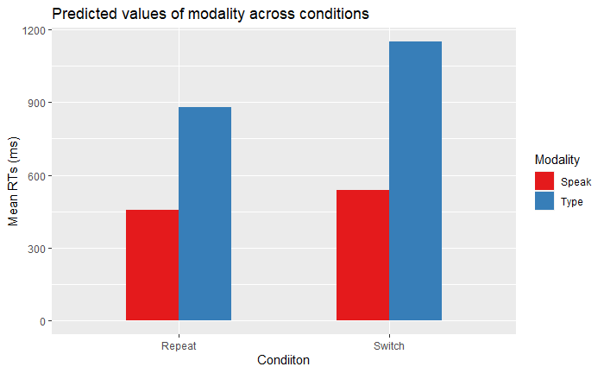
Predictions
Main effect of condition on reaction times (RT~Condition)

Slide 25
Predictions
Main effect of modality on reaction times (RT ~ Modality)

Slide 26
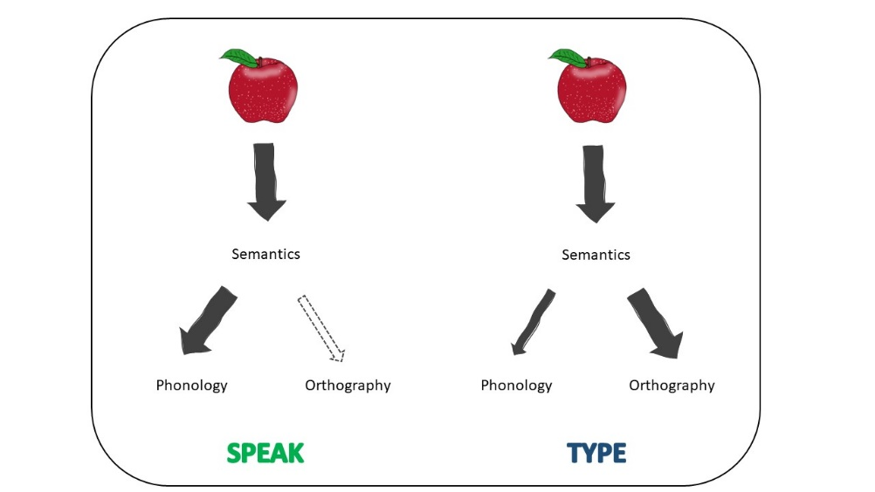
Predictions
Phonology strongly co-activated when typing.
Orthography weakly co-activated when speaking.

Slide 27
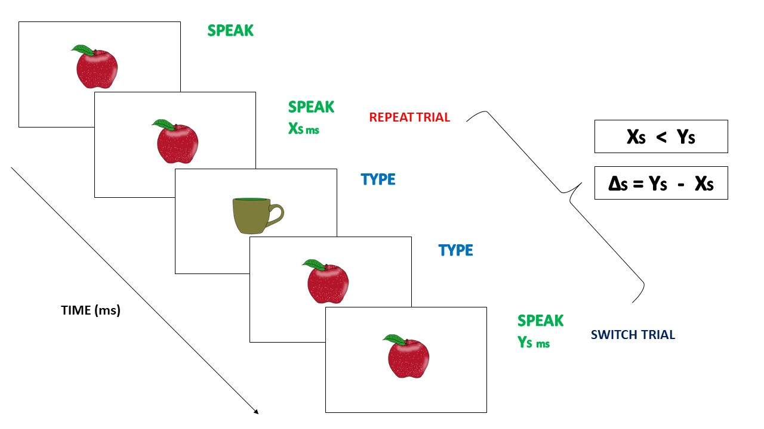
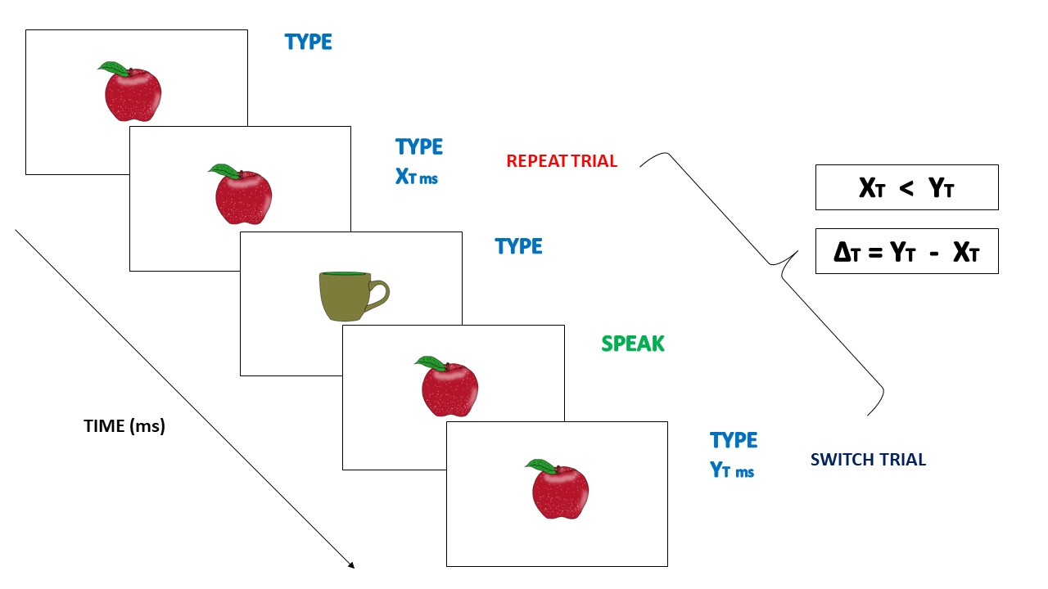
Predictions

Slide 28
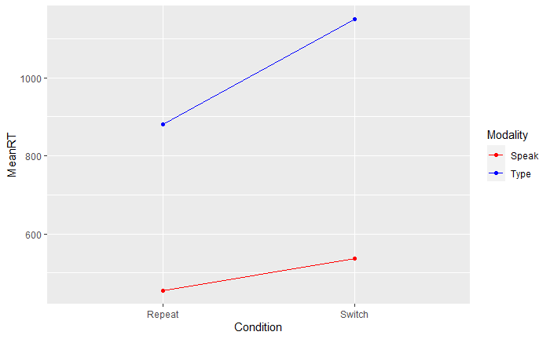
Predictions
Interaction: RT ~ Condition * Modality)
H1: If phonology is strongly co-activated when typing and orthography weakly co-activated when speaking, larger switch costs to typing than to speaking (for the same item) are expected (ΔS < ΔT)
H0: If orthography is also strongly co-activated when speaking, we do not expect larger switch costs to speaking than those to typing.
ΔT = 270ms
ΔS = 82ms

Slide 29
SECTION 4: Relevance
28

Slide 30
Relevance
Contribute to the research on the role of and interplay between phonological and orthographic representations and their co-activation during language production (oral – typed).
Employ typing instead of handwriting since the former is widely used and “taking over” handwriting in many everyday activities.
Speaking and typing are both basic parts of everyday communication and are often conducted simultaneously.
Theoretical and pragmatic implications regarding the dynamics of our two widely used ways of communication.

Slide 31


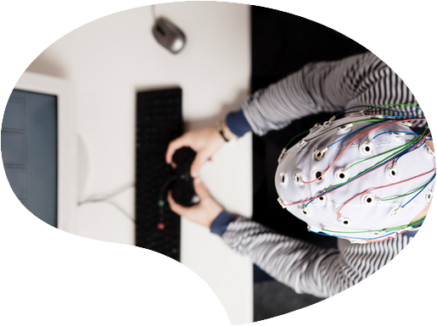
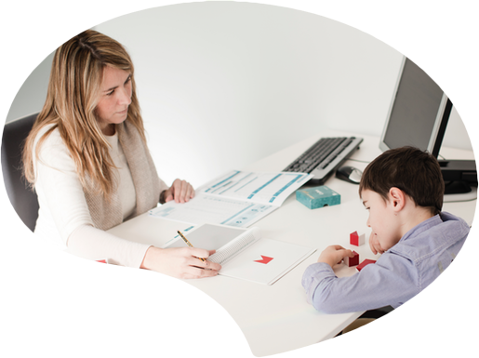
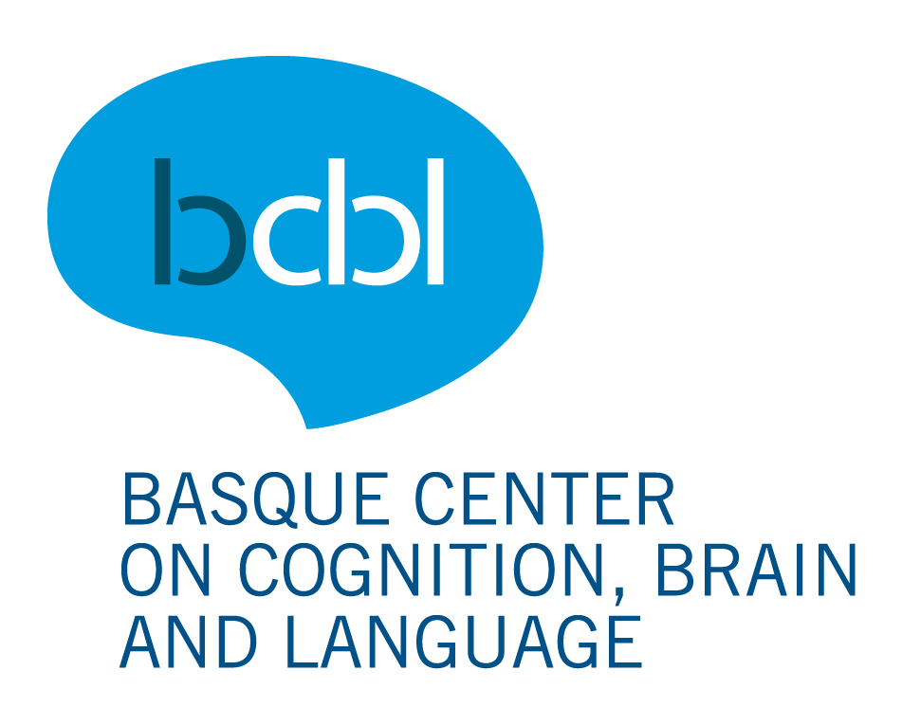

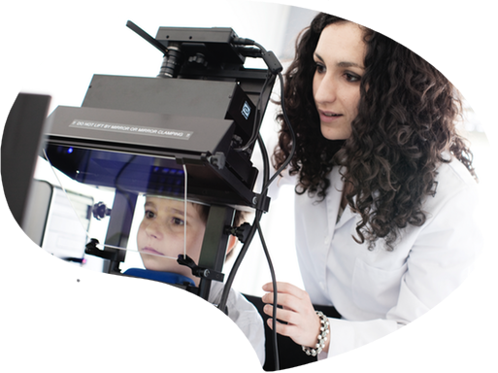
Vuestras preguntas?
Thank you!
Eskerrik asko!

Slide 32
Predictions
Phonetic & motoric priming:
Speech:
priming of phonetic features → /b/ - /d/
Speak Type
Speak (F) Speak (F)
Typing:
priming of motoric features → bigram priming <ro> - <ro>
Type Speak
Type (F) Type (F)
Notes:
See up to which level there is pre-activation:
Phonological vs. phonetic?
Prthographic vs. motoric?

Slide 33
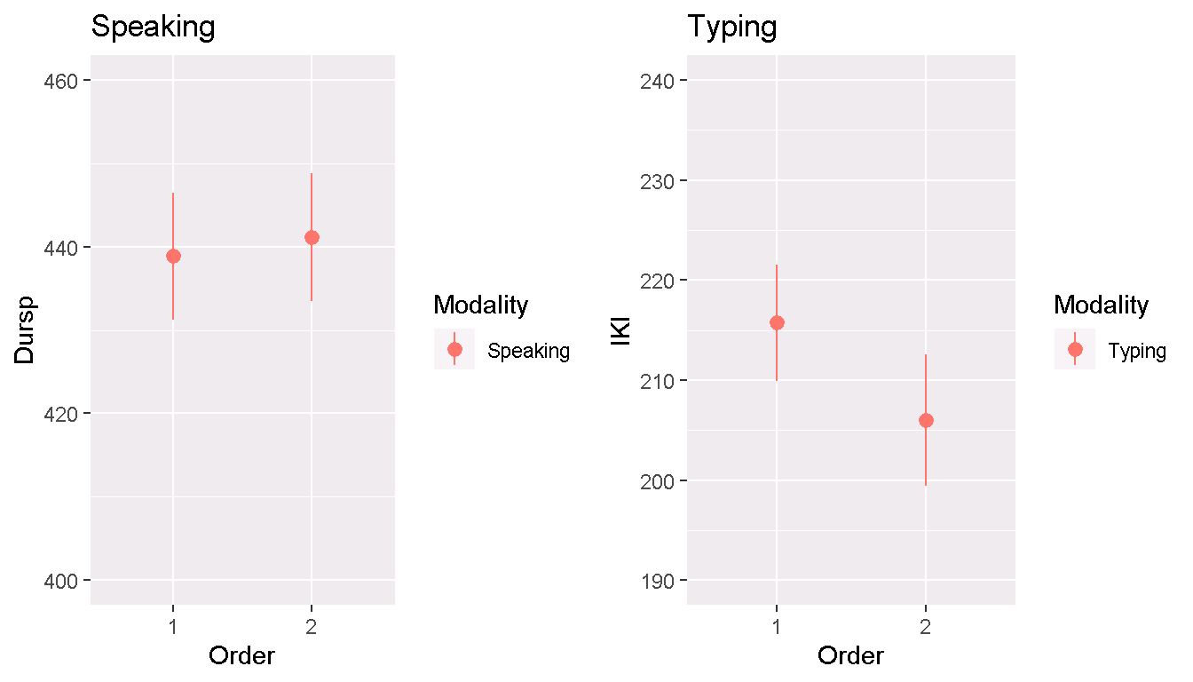
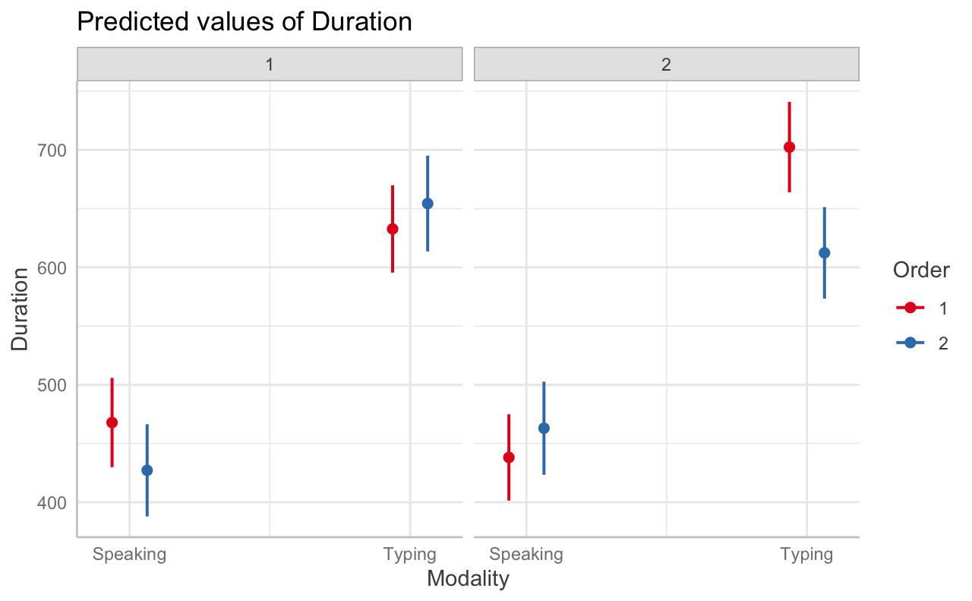
Predictions
Pinet & Martin (in prep)
Notes:
Left: Cross modal repetition → 1 & 2 are the order of blocks during the testing phase
Always T & S present but the order was counterbalanced btw sessions & participants
Effect of cross-modal priming of typed durations when typing is second (speaking block first).
Right: Interaction Modality*Order-Session → 2 sessions on different days
Previous effect interacts with session.
2nd day → there is a cross-modal priming effect on typing durations, but not on the 1st day/session
Strategic effect: you activate the orthographic representations during speaking when you know you are going to type afterwards → priming in typing is observed
The system is quite flexible.

